Slide 1
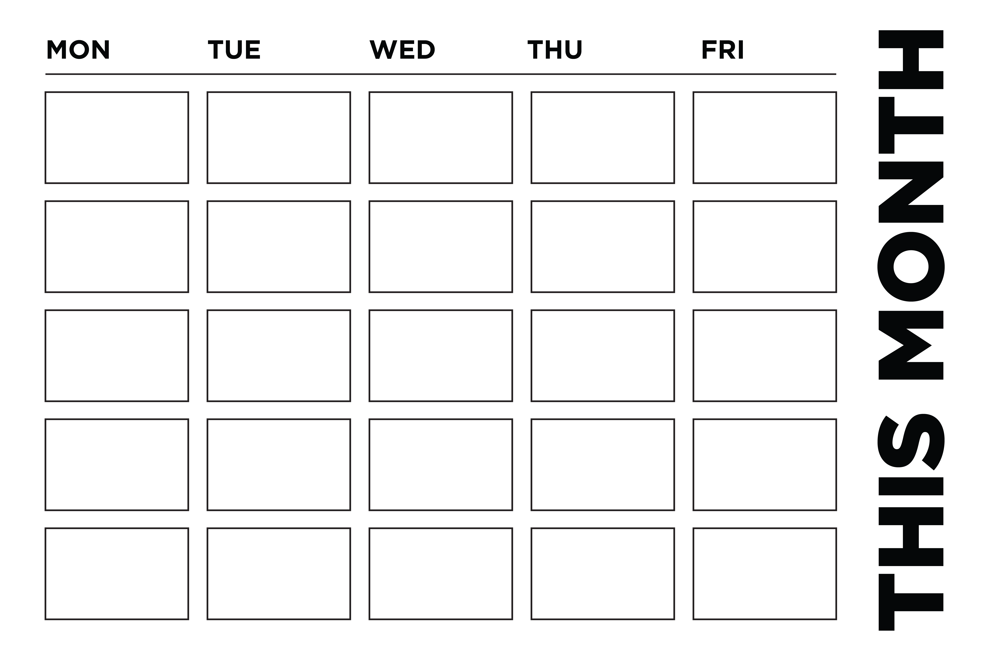
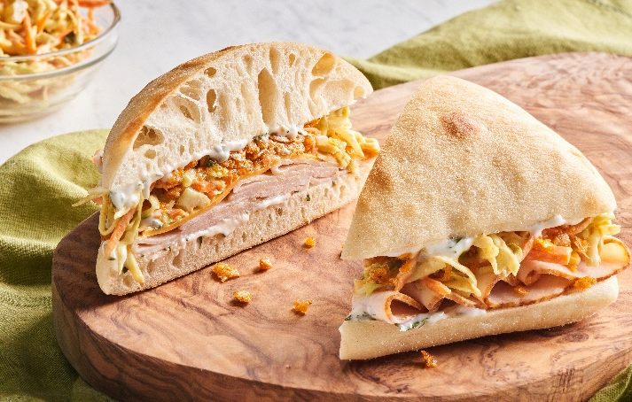

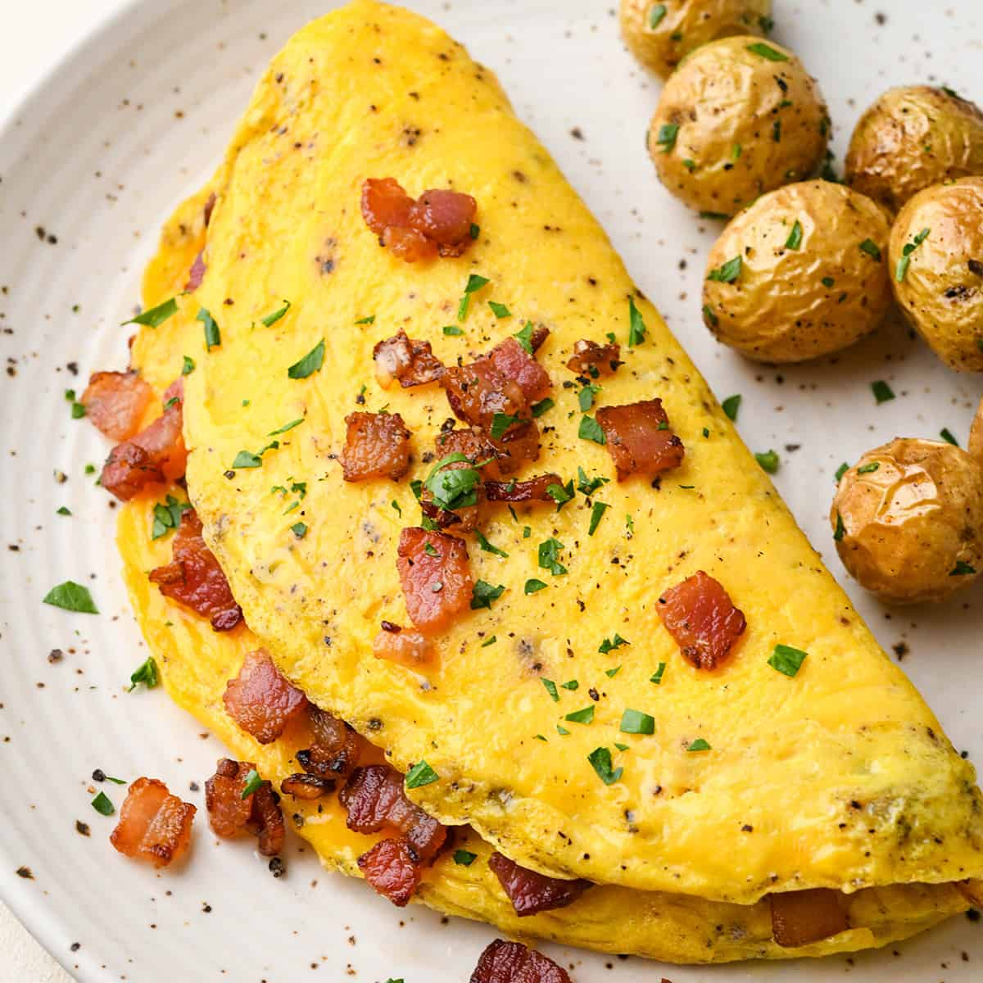
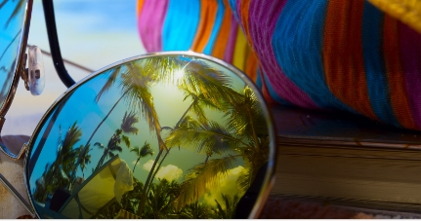



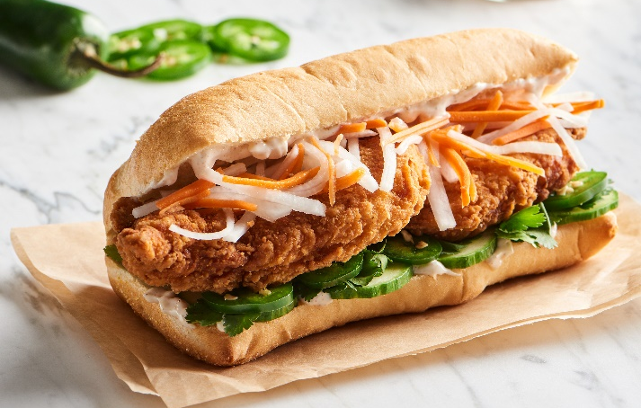
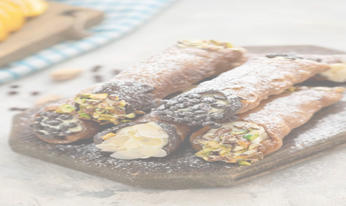
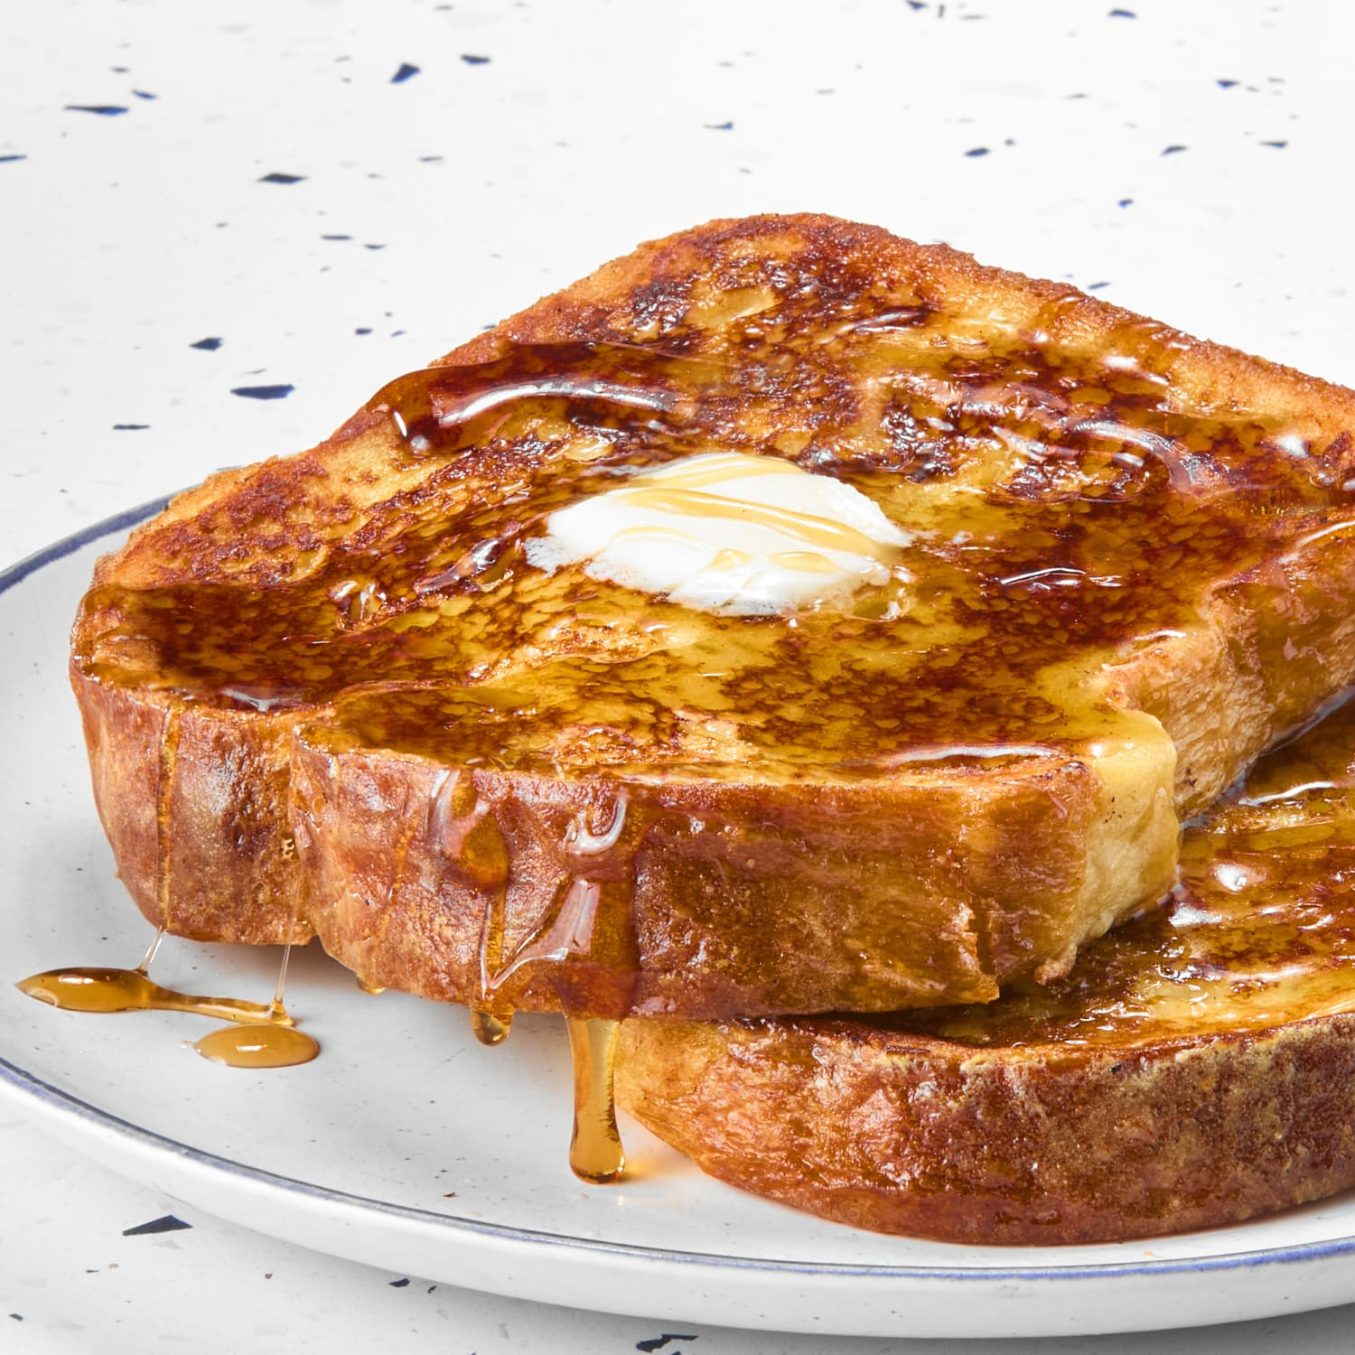
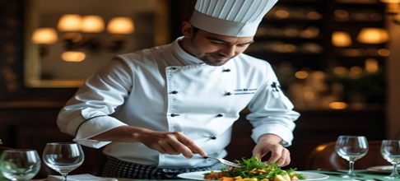
02
04
05
06
Turkey Crunch Ciabatta
Available
2/2 – 2/8
09
10
11
12
13
NJM Beach party
16
17
18
19
20
Chicken Bahn Mi
Available
2/16 – 2/22
Fresh Hand Made
Cannoli Available
@ Lunch
23
24
25
26
27
French Toast Bar
CHEF TABLE

